Slide 1
Improving Plan Performance with Re-enrollment
Speaker Name, Date, Other

Slide 2
Understanding Re-enrollment
01.
3 Important Things Re-enrollment Can Do for Your Company 401(k)
05.
Participants Appreciate Reenrollment
02.
Resetting Your Plan QDIA
06.
Why You Should Do This Now
03.
Personalization Means Suitability
07.
The Process of Conducting a Re-enrollment
04.
Personalization in Managed Accounts Drives Performance

Slide 3
3 Important Things Re-enrollment Can Do for Your Company 401(k)
01.
Realign the default (QDIA) investment strategy from a single factor (age-based) Target Date Fund to a personalized, goals-based advice solution
02.
Improve diversification for participants who have not adjusted their asset allocation in years
03.
Provide a professionally managed “easy button” for participants who lack experience or confidence making investment decisions

Slide 4
Resetting Your Plan QDIA
A Qualified Default Investment Alternatives (QDIA), provides a safe harbor for plan sponsors to default participants into risk- and age-based investment options when they do not make their own choices.
Changing your plan’s QDIA from a one-size-fits-all, age-based Target Date Fund to a goals-based, personalized advice program gives everyone a better chance of achieving financial independence.

Slide 5
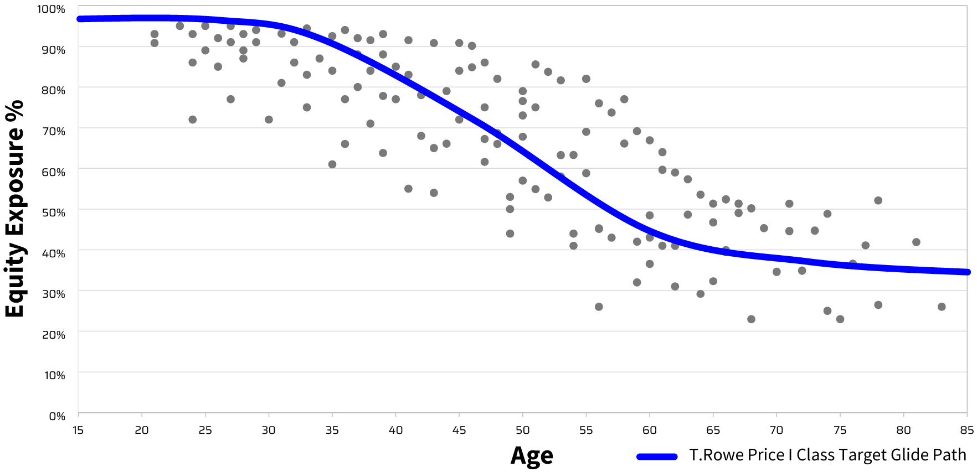
Personalization Means Suitability
Personalized equity asset allocations plotted against a sample age-based Target Date Fund glide path.
Suitability means aligning investment allocation and risk with each person’s needs and goals.

Slide 6
Personalization in Managed Accounts Drives Performance
MA Participants are
+26%
+64%
3.1x more likely to keep their assets in-plan
and
Higher overall savings rates¹
Much higher savings
rates for underfunded investors²
3.4x less likely to take a cash distribution
Based on 4.47% avg contribution rate before enrolling in a managed account vs. 5.64% after ¹
Based on 3.38% avg contribution rate before enrolling in a managed account vs. 5.53% after ¹
after leaving a company.³
1, 2 Transamerica: Managed Accounts in Retirement Plans; Measuring the impact of a personalized, goal-based retirement strategy, 2023
3 PLANADVISER 02/15/24 www.PlanAdviser.com/exclusives/efe-sees-managed-account-assets-hit-210b/
Prepared specifically for investment industry institutional use.

Slide 7
Participants Appreciate Re-enrollment
A majority of 401(k) plan participants are NOT confident about which investments to choose.¹
Participants’ confidence in knowing which 401(k) plan investment options They Should Invest In
9 in 10 are happy
with a re-enrollment.
Only 1 in 5 opt out
to choose their own investments.
Note: Total n = 1,281 Source: J.P. Morgan Plan Participant Research 2021
Source 1: JP Morgan Plan Participant Research 2021 Source 2: Alliance Bernstein survey on reenrollment

Slide 8
Why You Should Do This Now
01.
02.
03.
Re-enrollment puts employees on a personalized path to reach their investment goals.
Offering a personalized advice solutions adds value of your 401(k) benefit.
Personalized advice drives higher savings rates and successful savings behaviors.

Slide 9
The Process of Conducting a Re-enrollment
Communications to all employees
Required Notice Period
Opt out or Reenrollment is Automatic
Post-Enrollment Communications

